Slide 1
The Top Strategic Technology Trends for 2022
Notes:
Signature Series: The Top Strategic Technology Trends for 2022
David Groombridge
1 © 2021 Gartner, Inc. and/or its affiliates. All rights reserved. Gartner is a registered trademark of Gartner, Inc. and its affiliates.

Slide 2
Growth
CEO
The Gartner CEO Survey Flags Clear 2022 Priorities
Digitalization
CEO
Efficiency
CEO

Slide 3
Growth
CIO
Force Multipliers
CEO
CIO Priorities Result From the Business Need
Digitalization
CIO
Creative Technology
CEO
Efficiency
CIO
Scalable Foundation
CEO

Slide 4
Accelerating Growth
Growth
CIO
Force Multipliers
CEO
Priorities Create Key Themes for 2022
Sculpting Change
Digitalization
CIO
Creative Technology
CEO
Engineering Trust
Efficiency
CIO
Scalable Foundation
CEO

Slide 5










Accelerating Growth
Generative AI
Autonomic Systems
Total Experience
Distributed Enterprise
Gartner’s Top Strategic Technology Trends for 2022
Sculpting Change
AI Engineering
Hyperautomation
Decision Intelligence
Composable Applications
Engineering Trust
Cloud-Native Platforms
Privacy-Enhancing Computation
Cybersecurity Mesh
Data Fabric

Slide 6








Accelerating Growth
Generative AI
Autonomic Systems
Total Experience
Distributed Enterprise
Gartner’s Top Strategic Technology Trends for 2022
Sculpting Change
AI Engineering
Hyperautomation
Decision Intelligence
Composable Applications
Engineering Trust
Cloud-Native Platforms
Privacy-Enhancing Computation
Cybersecurity Mesh
Data Fabric

Slide 7
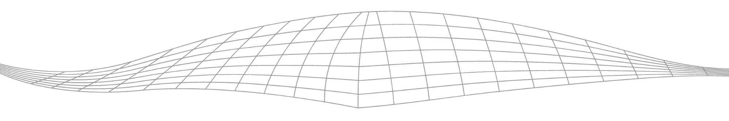
Data Fabric: Optimize Connections
Insights
Data Fabric
Things
Usage
Customers
Active Recommendations
Traditional Analytics/BI
Apps and Doc. Repositories
RDBMS
Data Lakes
Cloud Data Stores
Gartner Research: Data Fabric
Analysis by Mark Beyer et al.

Slide 8


Accelerate Time to Value With Data Fabric
Data Fabric allows clients to:
Have “no difference between our data models and conceptual models of the business problem”
Municipal Government Client
“Creep up the frontier of profitability”
Automotive Manufacturer

Slide 9




Cybersecurity Mesh: Secure Everywhere
Digital Assets
Composable Security Services
Adaptive Access
Content Control
Identity Mgmt.
Security Config.
Gartner Research: Cybersecurity Mesh
Analysis by Felix Gaehtgens, et al.

Slide 10


Evolve to a Cybersecurity Mesh Architecture
Composable Security and Identity Services
Users
Services
Security Tools
Mobile App
Web App
Consolidated Policy Management
Identity Fabric
Chat
Legacy Data
Security Analytics and Intelligence
IoT
Thing

Slide 11

Privacy-Enhancing Computation: Trust Anywhere
Gartner Research: Privacy-Enhancing Computation
Analysis by Bart Willemsen, Ramon Krikken and Mark Horvath
Photo by Jason Dent on Unsplash

Slide 12
Match Privacy Approach to Use Case
Trust
Trust
Data
Differential Privacy, Synthetic Data, Homomorphic Encryption (HE)
Al Modeling
Software
Secure Multiparty Computation, Zero-Knowledge Proofs, FedML, HE
Analytics
Hardware
Trusted Execution Environments, Trusted Third Party
Cross-border/Cloud

Slide 13
Cloud-Native Platforms: Enable Velocity
As-a-service
delivery model
Continuous
SW delivery
Loosely coupled/
independent services
Platform Services
Declarative APIs
Application developers
Infrastructure
Standardized, highly automated cloud services
Gartner Research: Cloud-Native Platforms
Analysis by Dennis Smith, Arun Chandrasekaran, Sid Nag, David Smith, Anne Thomas and Michael Warrilow

Slide 14
Apply Cloud-Native Architectural Principles
Your App
L
I
F
E
S
P
A
R
Cloud-Native App

Slide 15


Accelerating Growth
Generative AI
Autonomic Systems
Total Experience
Distributed Enterprise
Gartner’s Top Strategic Technology Trends for 2022
Sculpting Change
AI Engineering
Hyperautomation
Decision Intelligence
Composable Applications
Engineering Trust
Cloud-Native Platforms
Privacy-Enhancing Computation
Cybersecurity Mesh
Data Fabric

Slide 16
Composable Applications: Modularize Agility
Hurdles to Digitalization
Composable Applications
Modular
Skills
Efficient
Lock-In
Change
Adaptable
Speed
Gartner Research: Composable Applications
Analysis by Yefim Natis, Dennis Gaughan, Tad Travis, Kirk Knoernschild, Mark O’Neill, Gene Alvarez

Slide 17



Package Business Capabilities as Components
Packaged Business Capability
Composed Application
UI
Events
APIs
Application composition platform
Internal data

Slide 18

Decision Intelligence: Reinvent Thinking
Learn
Feedback and Exceptions
Capture
Interpret
Outcome
Act
Model
Resolve
Gartner Research: Decision Intelligence
Analysis by Pieter den Hamer et al.
Photo by Javier Allegue Barros on Unsplash

Slide 19

Compose Intelligent Decision-Making
Application Composable Platform
Decision Support
Decision Augmentation
Decision Automation
Decision Intelligence
Connected Insights
Contextual Analytics
Continuous Intelligence
Data Fabric

Slide 20
Hyperautomation: Reimagine Business
Fusion Teams
Better
Business Unit
Faster
Business Model Disruption
IT Driven
Cheaper
Efficiency
Cost Saving
Business Value
Gartner Research: Hyperautomation
Analysis by Stephanie Stoudt-Hansen, Frances Karamouzis, Keith Guttridge, Nicole Sturgill, Laurie Shotton

Slide 21








Focus on Three Outcomes to Drive Disruption
Data quality tools
82%
Quality
RPA
Integration platforms
68%
Speed
Process mining tools
Low-code platforms
63%
Agility
IoT platforms

Slide 22

AI Engineering: Operationalize AI
DataOps
Data Pipelines, Workflows Management
ModelOps
Model Engineering, Governance Lab
Accelerated Time to Value
DevOps
Endpoint Mgmt., Composability Svcs.
Gartner Research: AI Engineering
Analysis by Kevin Gabbard, Soyeb Barot, and Jitendra Subramanyam

Slide 23



Georgia Pacific:
Accelerated Value
Unity Health:
Model Credibility
Axon:
Ethical AI
https://www.gettyimages.com/detail/photo/huge-spools-of-paper-in-warehouse-of-a-printing-royalty-free-image/157483762?adppopup=true
https://www.gettyimages.com/detail/photo/justice-under-the-law-royalty-free-image/173678572?adppopup=true
Photo by National Cancer Institute on Unsplash
Photos by Fabio, National Cancer Institute, Riccardo Annandale on Unsplash

Slide 24
Accelerating Growth
Generative AI
Autonomic Systems
Total Experience
Distributed Enterprise
Gartner’s Top Strategic Technology Trends for 2022
Sculpting Change
AI Engineering
Hyperautomation
Decision Intelligence
Composable Applications
Engineering Trust
Cloud-Native Platforms
Privacy-Enhancing Computation
Cybersecurity Mesh
Data Fabric

Slide 25
Distributed Enterprise: Create Ecosystems
Hybrid Work
Distributed Services
Workers
Customers
Distributed Enterprise
Digital Enablement
Cybersecurity mesh
Cloud-native platforms
Data fabric
Composable applications
Gartner Research: Distributed Enterprise
Analysis by David Groombridge, Tony Harvey, Stuart Downes and Manjunath Bhat

Slide 26



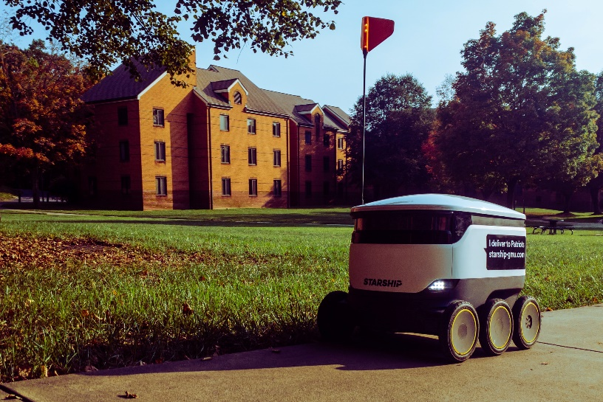


Reinvent Services for Distributed Consumers
Retail VR
Geolocated Services
Virtual Healthcare
Last-Mile Logistics
e-Events
Online Learning
Photos by Austin Neill, Bermix Studio, Marcus Loke, NASA, Mohammad Shahhosseini, Bill Nino, on Unsplash
Photo 1: by Marcus Loke on Unsplash
Photo 2: by NASA on Unsplash
Photo 3: by Bermix Studio on Unsplash
Photo 4: by Bill Nino on Unsplash
Photo 5: https://www.gettyimages.com/detail/photo/teleconferencing-with-music-royalty-free-image/1224017404?adppopup=true
Photo 6: by Mohammad Shahhosseini on Unsplash

Slide 27


Total Experience (TX): Connect Value
Customer Experience
CX
EX
Employee Experience
MX
UX
User Experience
Multiexperience
Gartner Research: Total Experience
Analysis by Jason Wong, Michelle Duerst, Don Scheibenreif, Saul Brand, Michael Chiu, and Van Baker

Slide 28
Total Experience (TX): Connect Value
Customer Experience
CX
EX
Employee Experience
MX
UX
User Experience
Multiexperience
Gartner Research: Total Experience
Analysis by Jason Wong, Michelle Duerst, Don Scheibenreif, Saul Brand, Michael Chiu, and Van Baker

Slide 29
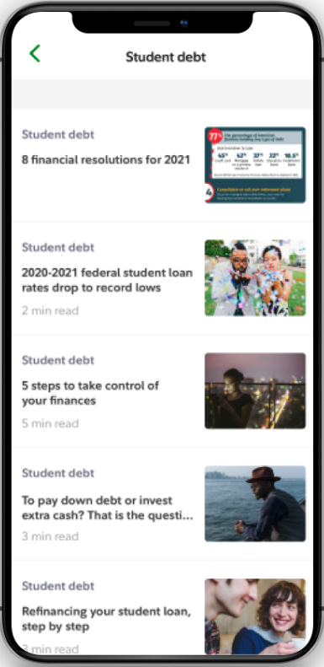
Explore Total Experience for Value
AI prepares for client’s next best action
ML creates virtual client simulations for training
CX
EX
MX
UX
Unified identity for seamless interaction across touchpoints
Analytics generates self-service onboarding dashboard
Source: Fidelity

Slide 30
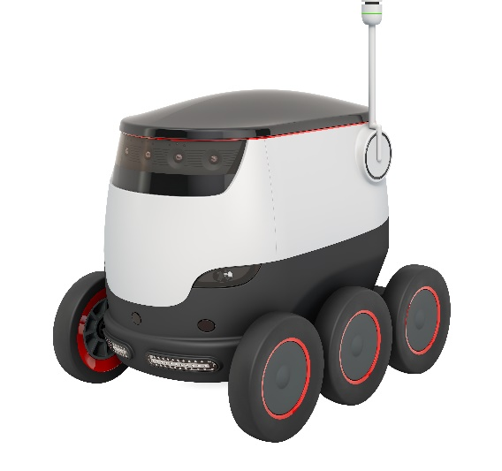

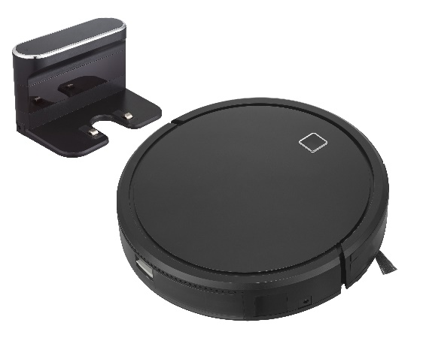
Autonomic Systems: Rethink Learning
Automated
Autonomous
Autonomic
Behavior:
Algorithm:
Fixed
Fixed
Adaptable
Fixed
Adaptable
Self-modifying
Gartner Research: Autonomic Systems
Analysis by Nick Jones, Erick Brethenoux and David Cearley
https://www.gettyimages.com/detail/photo/cleaner-robot-royalty-free-image/1175873051?adppopup=true
https://www.gettyimages.com/detail/photo/autonomous-robot-3d-rendering-isolated-on-white-royalty-free-image/1220222515?adppopup=true
https://www.gettyimages.com/detail/photo/smart-business-woman-royalty-free-image/624223888?adppopup=true

Slide 31
Evaluate Autonomic Opportunities and Risks
Challenges
Ethics
Cost
Liability
Fast reactions
Public concern
Independence
Unpredictability
Changing goals
Immaturity
Learnable tasks
Opportunities
2021 Rare
2023 Emerging
2025 Mainstream

Slide 32









Generative AI: Innovate Beyond
Conclusions
Today
AI
Creations
Emerging
Gartner Research: Generative AI
Analysis by Anthony Mullen, Marc Halpern, Soyeb Barot, Nicole Greene, Brent Stewart

Slide 33

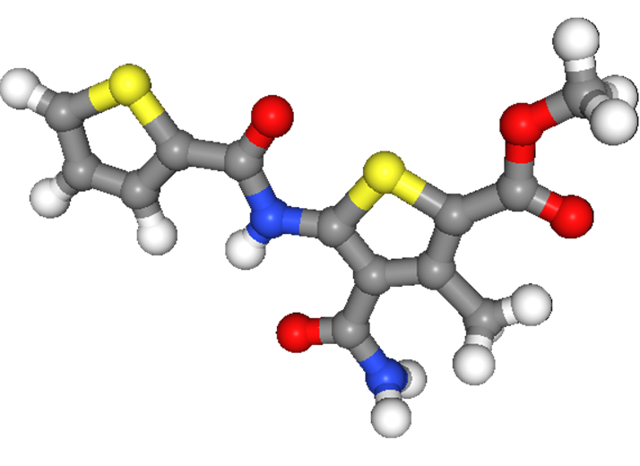
Deploy Generative AI to Create New IP
Synthesizing Data
AI Writing Code
Creating Products
Photos of faces
User request: “Calculate factorial”
Structures of existing drugs
Input Data
Output
import math
print("Enter a number: ")
num = int(input())
factorial_number = 1
for i in range(1, num + 1):
factorial_number *= i
print(factorial_number)
Source: thispersondoesnotexist.com
Source: sourceai.dev
Source: thischemicaldoesnotexist.com

Slide 34
Accelerating Growth
Generative AI
Autonomic Systems
Total Experience
Distributed Enterprise
Gartner’s Top Strategic Technology Trends for 2022
Sculpting Change
AI Engineering
Hyperautomation
Decision Intelligence
Composable Applications
Engineering Trust
Cloud-Native Platforms
Privacy-Enhancing Computation
Cybersecurity Mesh
Data Fabric

Slide 35
Recommended Gartner Research
Top Strategic Technology Trends for 2022 David Groombridge et al. (G00757234)
2021 Hype Cycles: Innovating Delivery Through Trust, Growth and Change Philip Dawson (G00755981)
A Tapestry (TPESTRE) of Trends for Strategic Planning Marty Resnick et al. (G00742004)

Slide 36

By 2024, data fabric deployments will quadruple efficiency in data utilization while cutting human-driven data management tasks in half.
Engineering Trust
Data Fabric
Gartner Strategic Planning Assumption Analysis by Mark Beyer et al.
Gartner Research: Data Fabric
Analysis by Mark Beyer et al.

Slide 37
By 2024, organizations adopting a cybersecurity mesh architecture to integrate security tools to work as a collaborative ecosystem will reduce the financial impact of individual security incidents by an average of 90%.
Engineering Trust
Cybersecurity Mesh
Gartner Strategic Planning Assumption Analysis by Felix Gaehtgens et al.
Gartner Research: Cybersecurity Mesh
Analysis by Felix Gaehtgens, et al.

Slide 38
By 2025, 60% of large organizations will use one or more privacy-enhancing computation techniques in analytics, business intelligence or cloud computing.
Engineering Trust
Privacy-Enhancing Computation
Gartner Strategic Planning Assumption Analysis by Bart Willemsen, Ramon Krikken and Mark Horvath
Gartner Research: Privacy-Enhancing Computation
Analysis by Bart Willemsen, Ramon Krikken and Mark Horvath

Slide 39
By 2025, cloud-native platforms will serve as the foundation for more than 95% of new digital initiatives, up from less than 40% in 2021.
Engineering Trust
Cloud-Native Platforms
Gartner Strategic Planning Assumption Analysis by Dennis Smith, Michael Warrilow, Arun Chandrasekaran, Anne Thomas, Sid Nag and David Smith
Gartner Research: Cloud-Native Platforms
Analysis by Dennis Smith, Arun Chandrasekaran, Sid Nag, David Smith, Anne Thomas and Michael Warrilow

Slide 40

By 2024, the design mantra for new SaaS and custom applications will be “composable API-first or API-only,” rendering traditional SaaS and custom applications “legacy.”
Sculpting Change
Composable Applications
Gartner Strategic Planning Assumption Analysis by Yefim Natis, Dennis Gaughan, Tad Travis, Kirk Knoernschild, Mark O’Neill, Gene Alvarez
Gartner Research: Composable Applications
Analysis by Yefim Natis, Dennis Gaughan, Tad Travis, Kirk Knoernschild, Mark O’Neill, Gene Alvarez

Slide 41
By 2023, more than 33% of large organizations will have analysts practicing decision intelligence (including decision modelling).
Sculpting Change
Decision Intelligence
Gartner Strategic Planning Assumption Analysis by Pieter den Hamer et al.
Gartner Research: Decision Intelligence
Analysis by Pieter den Hamer et al.

Slide 42
By 2024, diffuse hyperautomation spending will drive up the total cost of ownership 40-fold, making adaptive governance a differentiating factor in corporate performance.
Sculpting Change
Hyperautomation
Gartner Strategic Planning Assumption Analysis by Stephanie Stoudt-Hansen, Frances Karamouzis, Keith Guttridge, Nicole Sturgill, Laurie Shotton
Gartner Research: Hyperautomation
Analysis by Stephanie Stoudt-Hansen, Frances Karamouzis, Keith Guttridge, Nicole Sturgill, Laurie Shotton

Slide 43
By 2025, the 10% of enterprises who establish AI engineering best practices will generate at least three times more value with their AI efforts than the 90% of enterprises who do not.
Sculpting Change
AI Engineering
Gartner Strategic Planning Assumption Analysis by Kevin Gabbard, Soyeb Barot, and Jitendra Subramanyam
Gartner Research: AI Engineering
Analysis by Kevin Gabbard, Soyeb Barot, and Jitendra Subramanyam

Slide 44

By 2023, 75% of organizations that exploit distributed enterprise benefits will realize revenue growth 25% faster than competitors.
Accelerating Growth
Distributed Enterprise
Gartner Strategic Planning Assumption Analysis by David Groombridge, Tony Harvey, Stuart Downes and Manjunath Bhat
Gartner Research: Distributed Enterprise
Analysis by David Groombridge, Tony Harvey, Stuart Downes and Manjunath Bhat

Slide 45
By 2026, 60% of large enterprises will use total experience to transform their business models to achieve world-class customer and employee advocacy levels.
Accelerating Growth
Total Experience
Gartner Strategic Planning Assumption Analysis by Jason Wong, Michelle Duerst, Don Scheibenreif, Saul Brand, Michael Chiu, and Van Baker
Gartner Research: Total Experience
Analysis by Jason Wong, Michelle Duerst, Don Scheibenreif, Saul Brand, Michael Chiu, and Van Baker

Slide 46
By 2024, 20% of organisations that sell autonomic systems or devices will require customers to waive indemnity provisions related to their products’ learned behavior.
Sculpting Change
Autonomic Systems
Gartner Strategic Planning Assumption Analysis by Nick Jones, Erick Brethenoux and David Cearley
Gartner Research: Autonomic Systems
Analysis by Nick Jones, Erick Brethenoux and David Cearley

Slide 47
By 2025, generative AI will account for 10% of all data produced, up from less than 1% today.
Accelerating Growth
Generative AI
Gartner Strategic Planning Assumption Analysis by Anthony Mullen, Marc Halpern, Soyeb Barot, Nicole Greene and Brent Stewart.
Gartner Research: Generative AI
Analysis by Anthony Mullen, Marc Halpern, Soyeb Barot, Nicole Greene, Brent Stewart

